Slide 1
ORDER MANAGEMENT SYSTEM
MEMBERS:
Elakkiyan T (9517202406019)
Kesavan G (9517202406045)
Mohan Raj N (9517202406055)
Department of Information Technology
Mepco Schlenk Engineering College
Department of IT
1

Slide 2
Problem Statement
Arasan Aluminium Industry uses only phone calls and emails for orders. This causes many problems. Orders have many errors. Processing takes 2-3 hours per order. Stock tracking is poor with errors. Customer data is scattered in different places. Sales reports take too long to make. Production planning is difficult. These problems cause losses every year. Customer satisfaction is low. The business cannot grow well in the competitive market.

Slide 3
Objective
1. Reduce Order Processing Time Cut order handling from 3 hours to 30 minutes.
2. Eliminate Order Errors Remove manual entry mistakes with digital system.
3. Track Stock Accurately Know exactly what products are available in real-time.
4. Centralize Customer Data Keep all client information in one secure place.
5. Generate Reports Automatically Create sales and stock reports with one click.

Slide 4
Outcome
Java-based system developed for order management Easy-to-use interface for all operations.
Secure MySQL database implemented All order and inventory data stored safely.
Automated order processing and stock updates Improved accuracy and reduced manual work.
Real-time stock tracking with alerts Prevents shortages and overstocking.
Efficient customer and order management Easy to add, update, and track information.

Slide 5
Input
Customer details (company name, contact person, address, phone, email, etc.)
Product details (product code, name, description, price, stock, etc.)
Order details (order date, customer, products, quantities, etc.)
Stock updates (when new stock arrives or stock is adjusted)
User login (if we have authentication)

Slide 6
Output
Secure storage of customer, product, and order data in MySQL database
Display of order details, inventory status, and customer information through Java interface
Automatically generated invoices and order summaries
Updated and accurate inventory records after each transaction
Efficient retrieval of order history and product availability when required

Slide 7
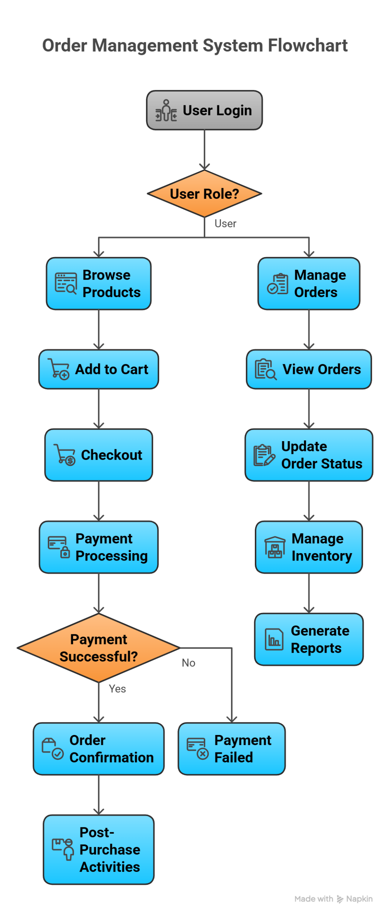
Flow Chart
User
Admin

Slide 8
Work Flow
Main Flow :
START
Login Id
(User or
Admin)
ADMIN FLOW
USER FLOW
1
2

Slide 9
1
USER FLOW :
Login / Sign Up
View Products
View Product Details
Give Feedback
View Order History and track (date, id, amount, status)
Place Order (Qty,Confirm)
Payment
Order Placed Successfully
END

Slide 10
2
Admin Login
ADMIN FLOW:
Admin Dashboard
View Options
Stock details
Feedback
Order history
Current orders
View Order History
View Current Orders (date, user id, order id,order details)
Product Stock
Add product Update product
View Customer Feedback
Accept Order
Update Order Status
(accepted/dispatched/delivered)
END

Slide 11
Class Diagram
User
userId:int
Name:string
Email:string
Password:string
Login:void()
signUp:void()
viewProducts:void()
placeOrder:void()
viewOrderHistory:void()
giveFeedback:void()
Admin
adminId:int
Username:string
Password:string
Login:void()
addProduct:void()
updateProduct:void()
viewCurrentOrders:void()
updateOrderStatus:void()
addRawMaterial:void()
updateRawMaterial:void()
viewFeedback:void()
RawMaterialOrder:void()

Slide 12
Product
productid:int
productName:string
Price:int
stockQty:int
getDetails:void()
updateStock:void()
Order
orderId:int
orderDate:int
status (accepted / dispatched / delivered)
totalAmount:double
createOrder:void()
updateStatus:void()

Slide 13
Payment
paymentId:int
paymentDate:int
Amount:double
paymentStatus:string
makePayment:void()
Feedback
feedbackId:int
Message:string
Rating:int

Slide 14
RawMaterial
materialId:int
materialName:string
Quantity:int
addMaterial:void()
updateMaterial:void()
Stock
stockId:int
availableQty:int
updateStock:void()

Slide 15
RawMaterialOrder
rawOrderId:int
orderDate:int
totalAmount:double
Status:string
placeRawMaterialOrder:void()
updateRawOrderStatus:void()

Slide 16
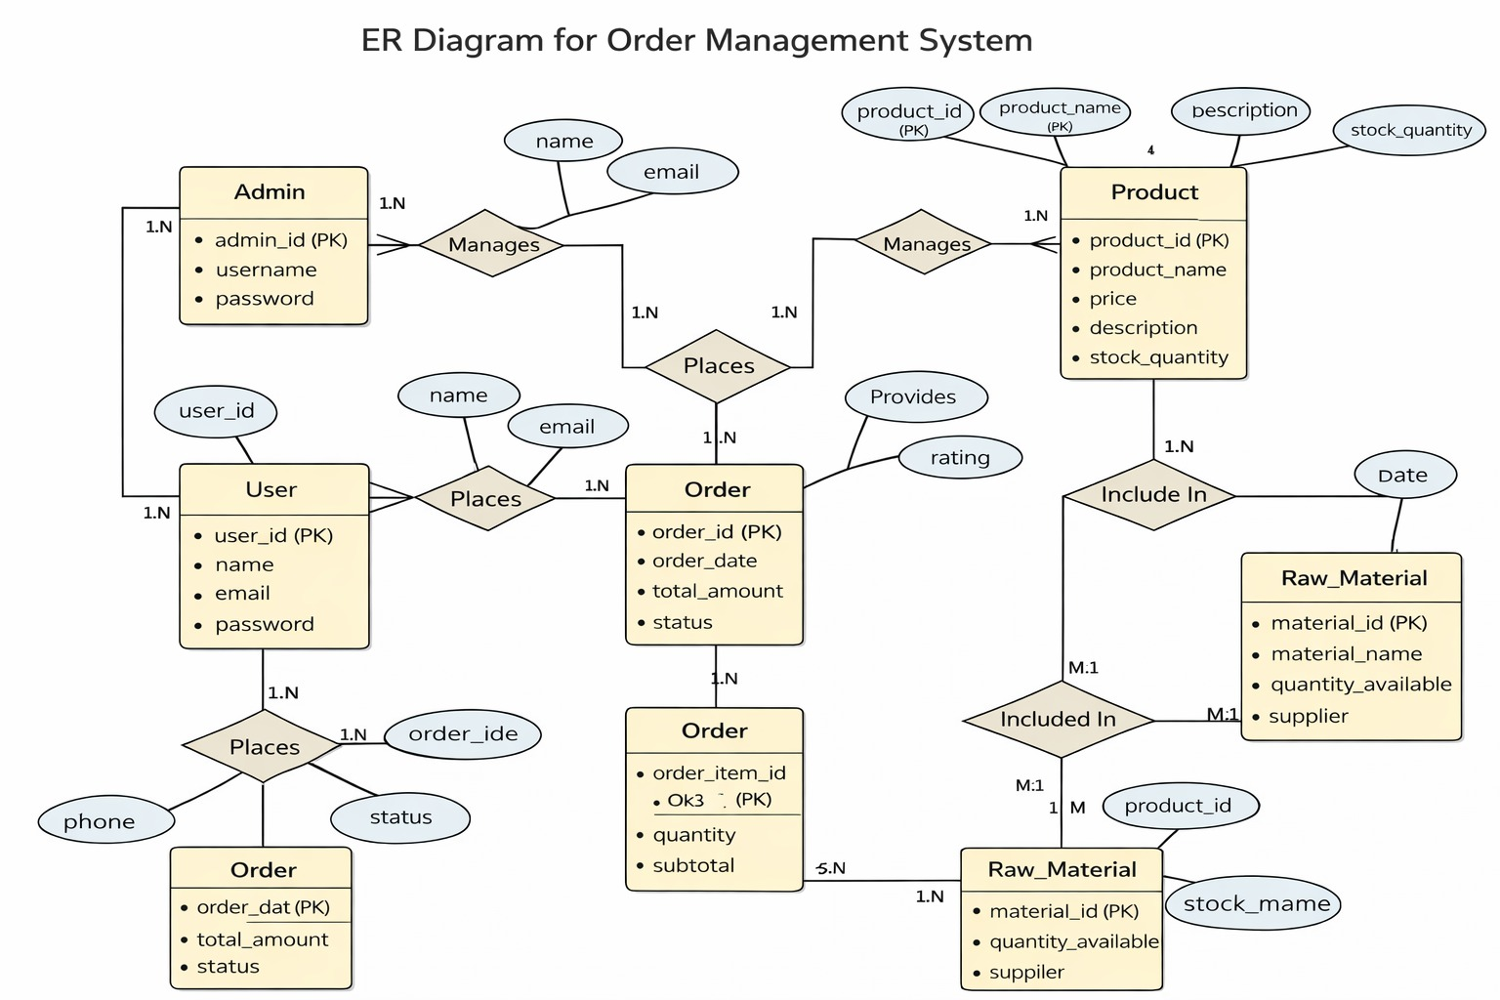
ER Diagrams

Slide 17
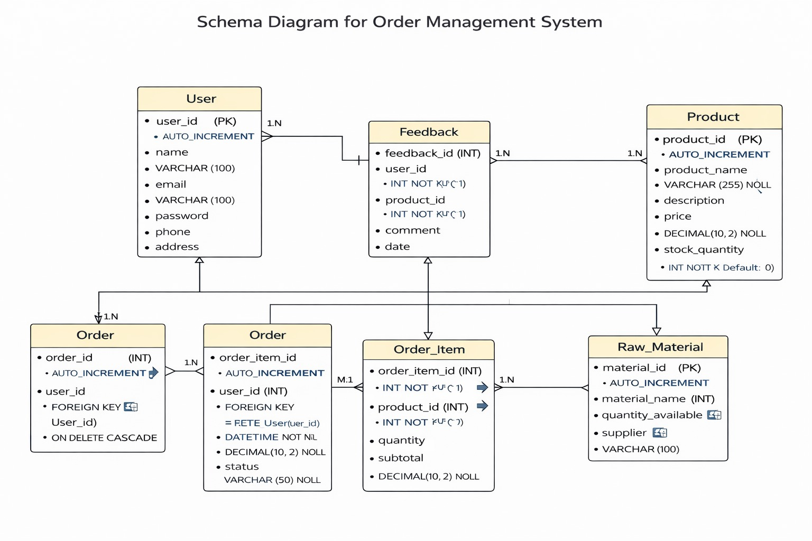
Schema Diagram

Slide 18
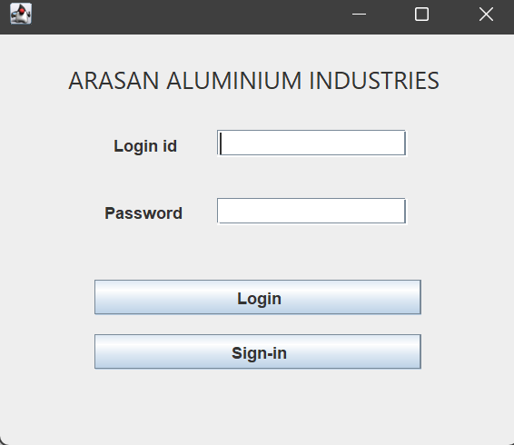
IMPLEMENTATION

Slide 19
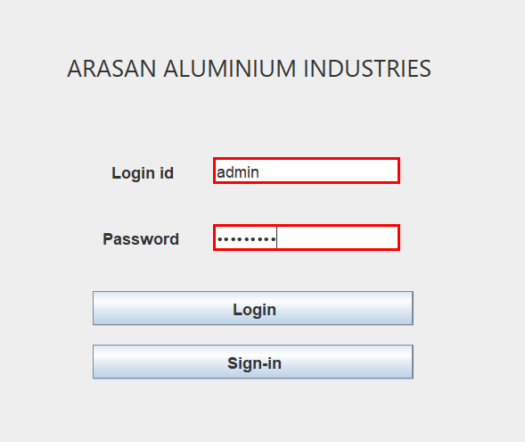

Slide 20
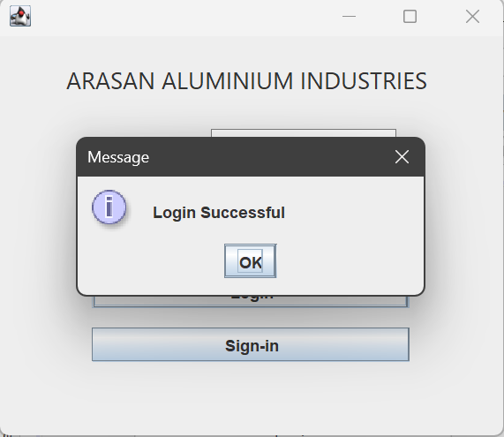

Slide 21
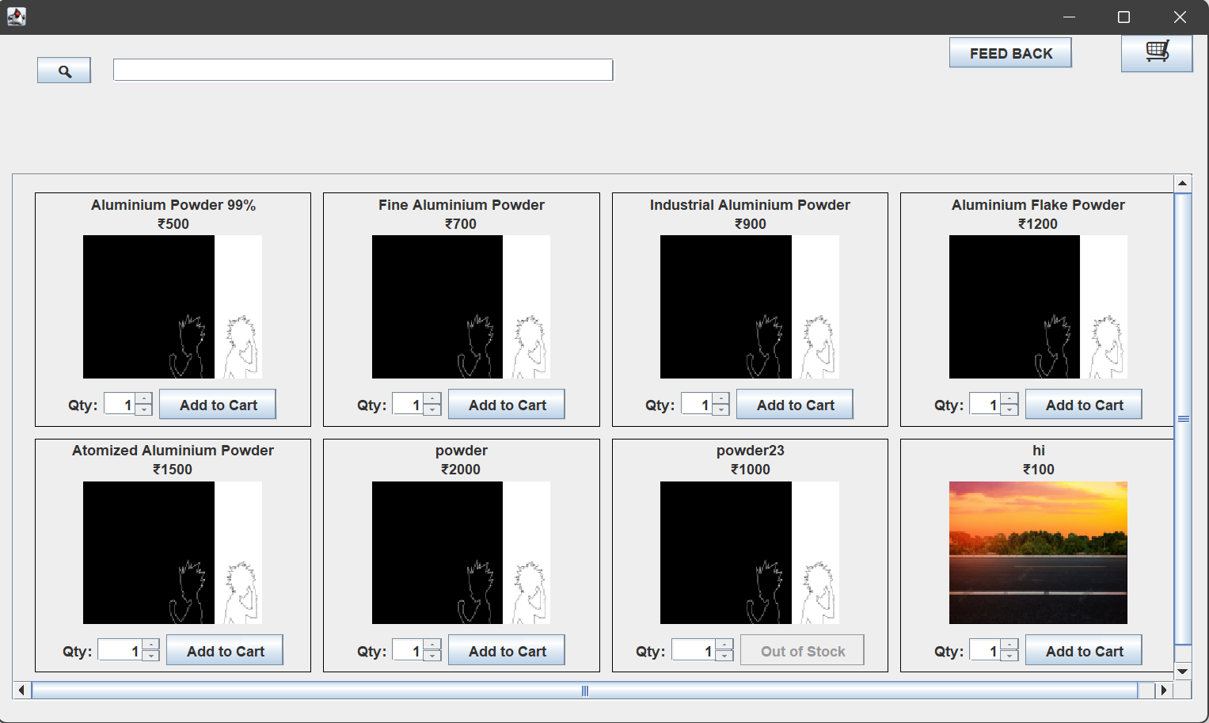

Slide 22
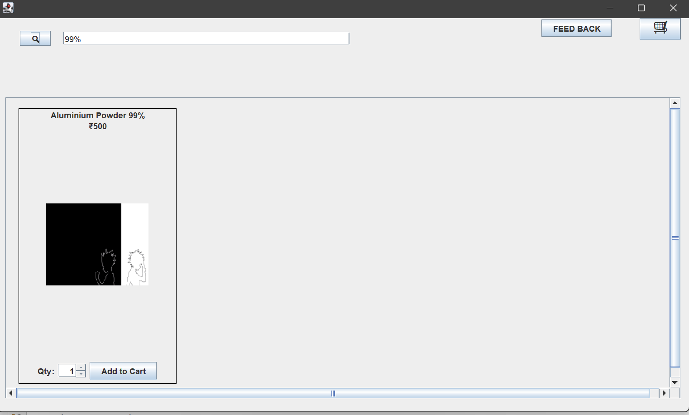

Slide 23
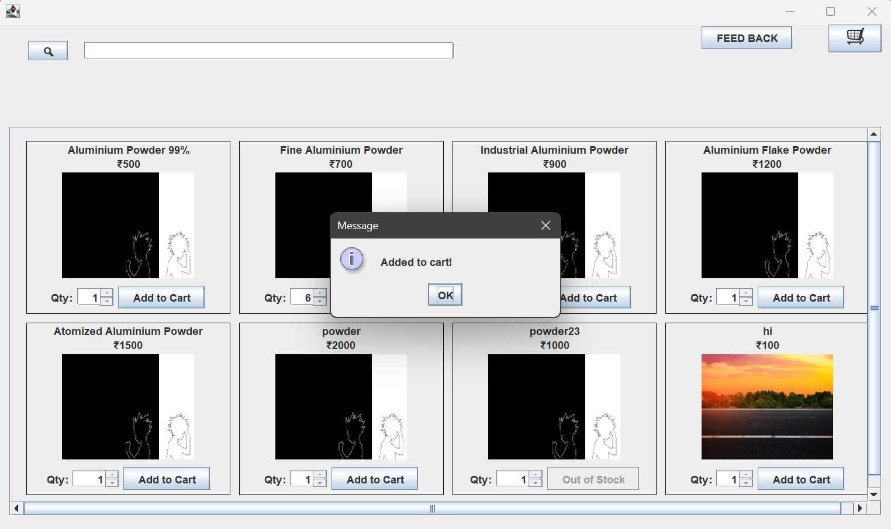

Slide 24
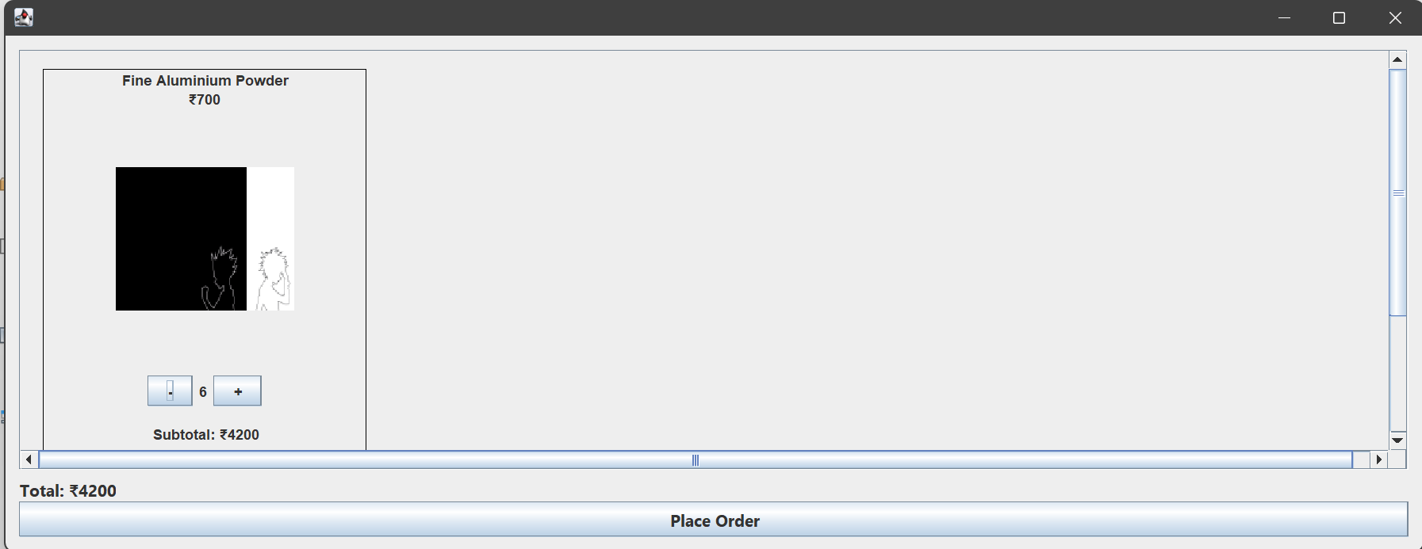
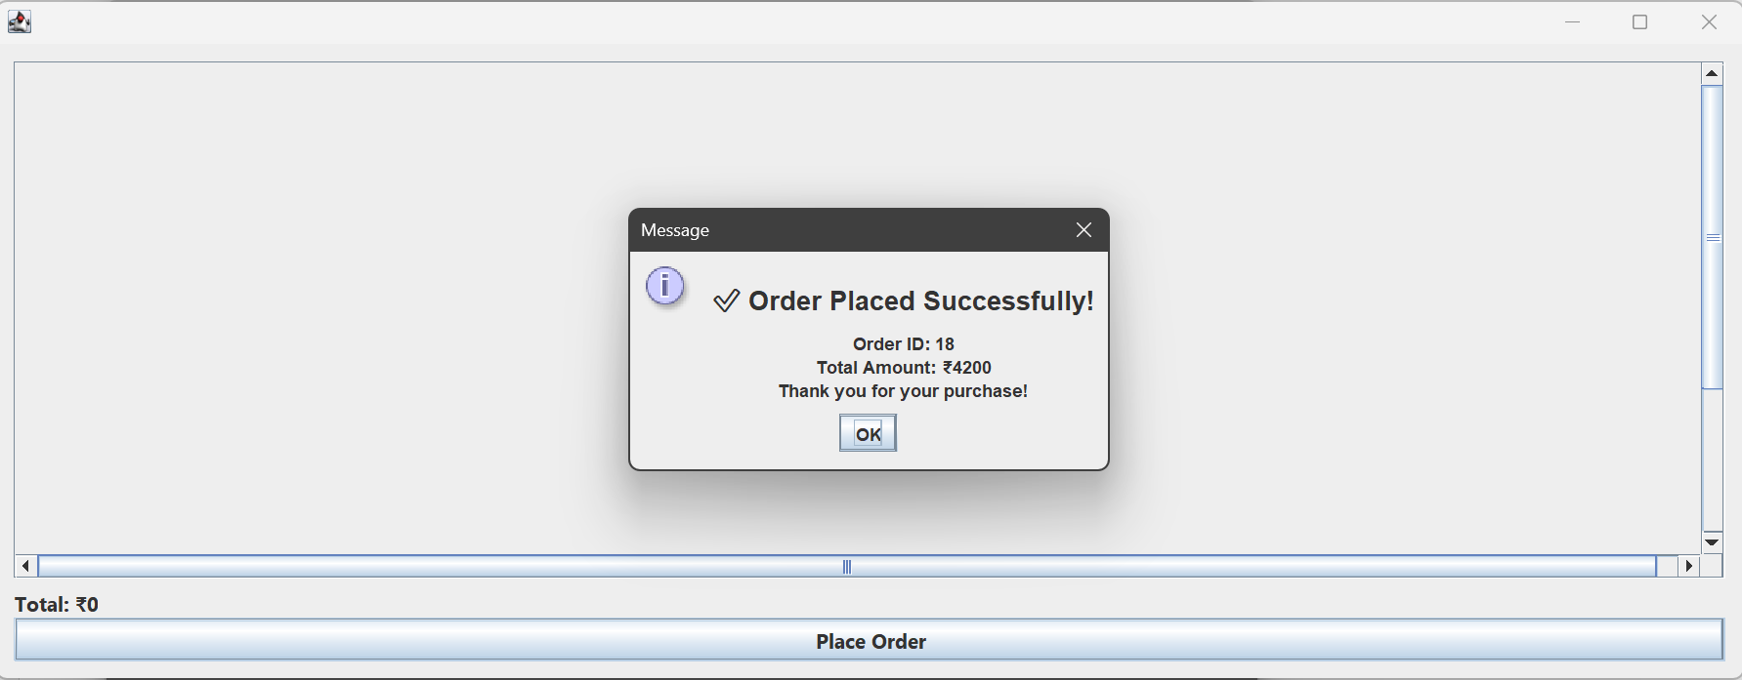

Slide 25
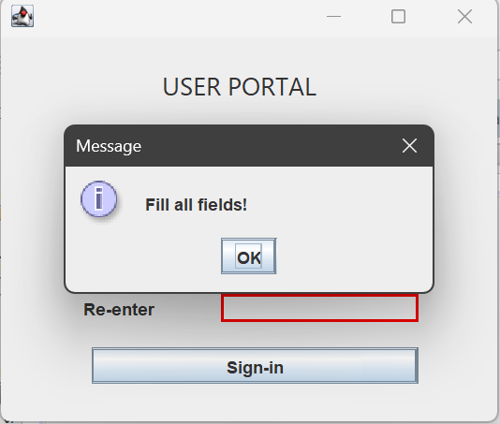
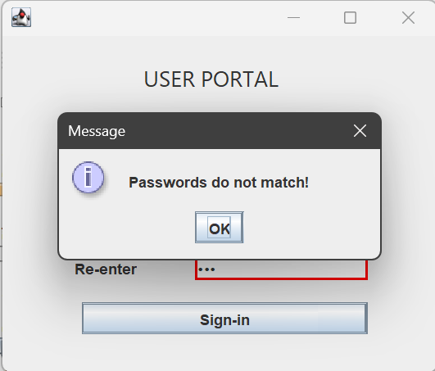
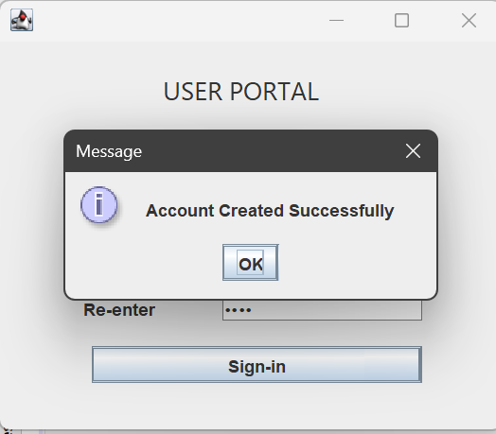
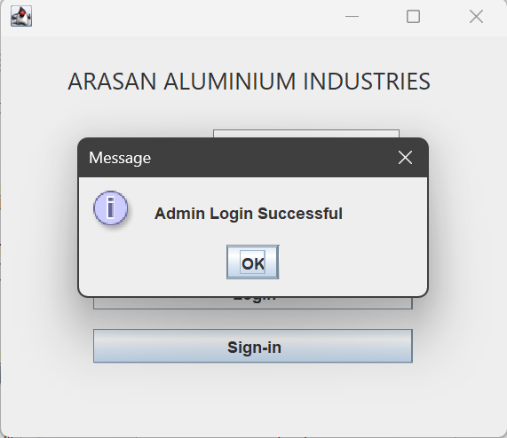

Slide 26
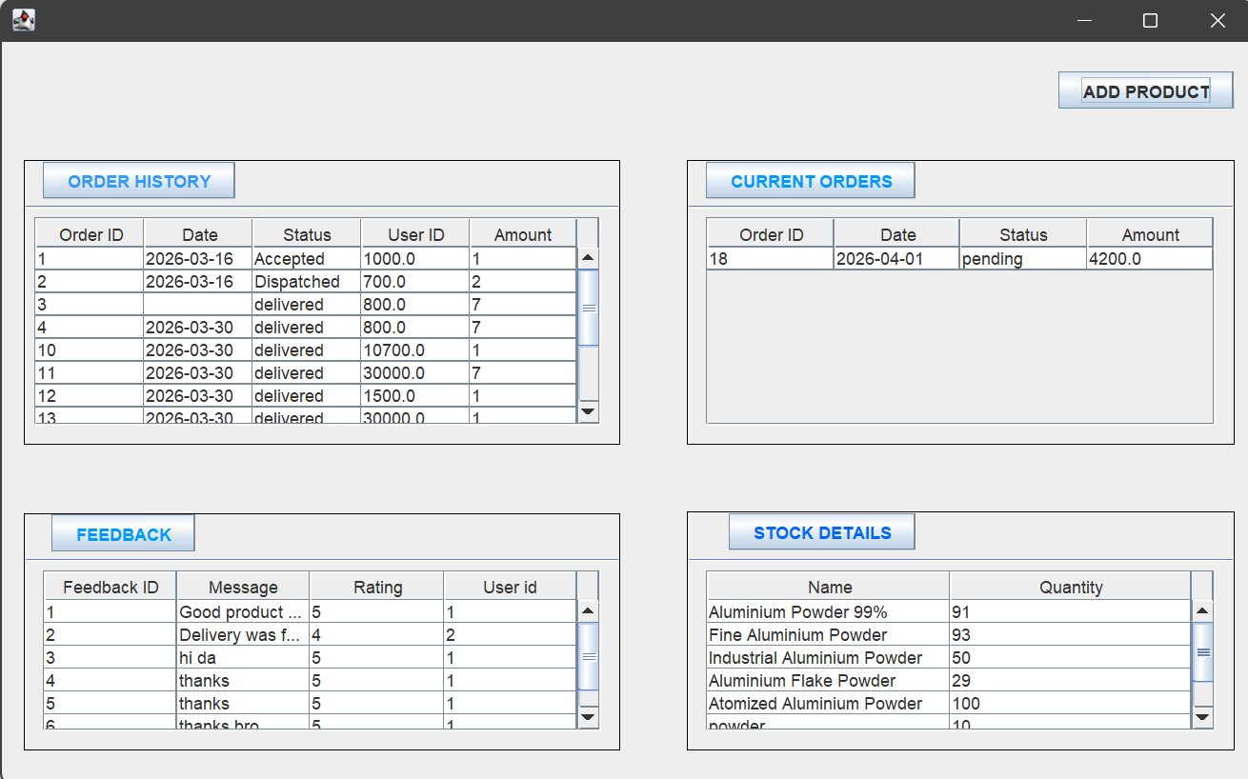

Slide 27
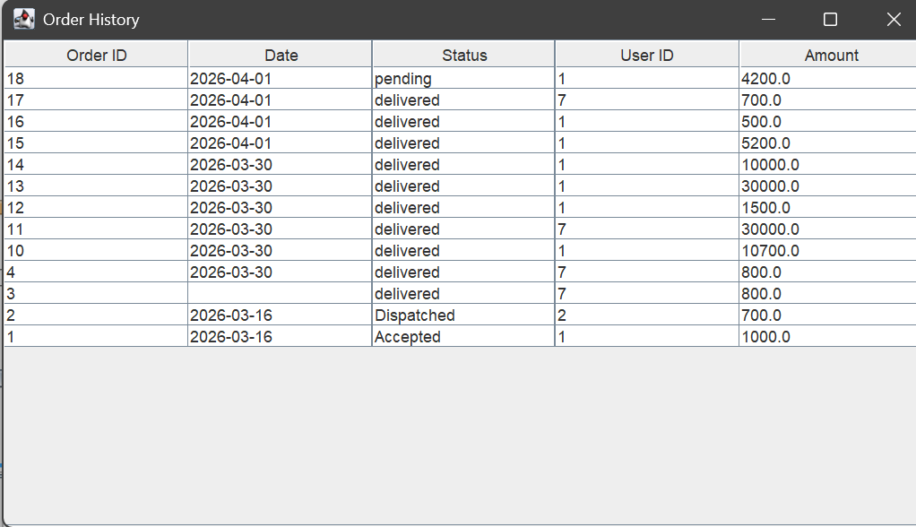
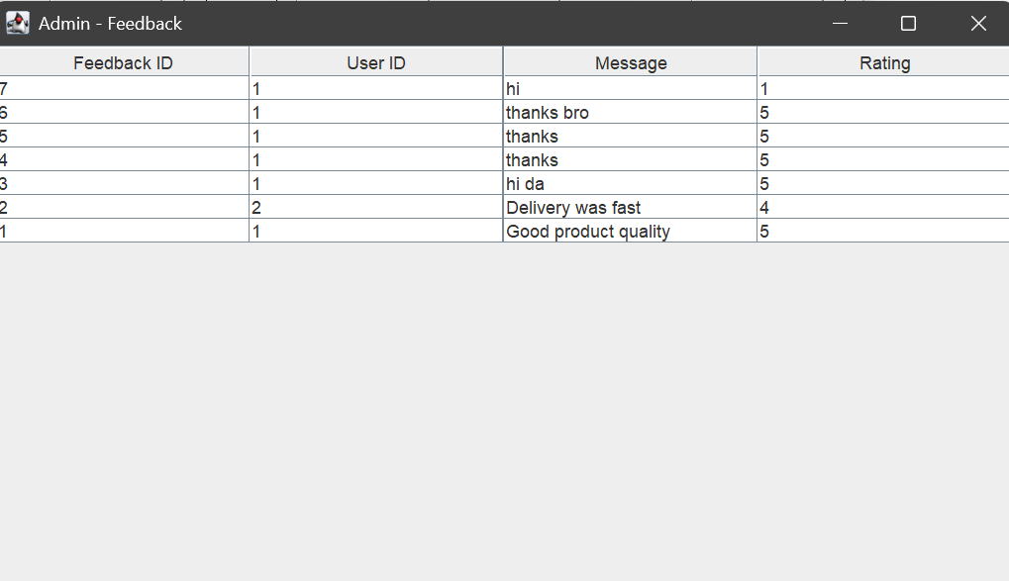

Slide 28
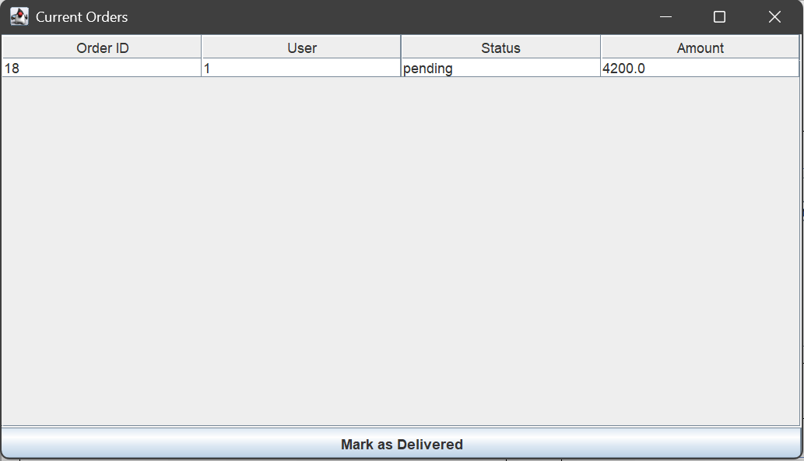
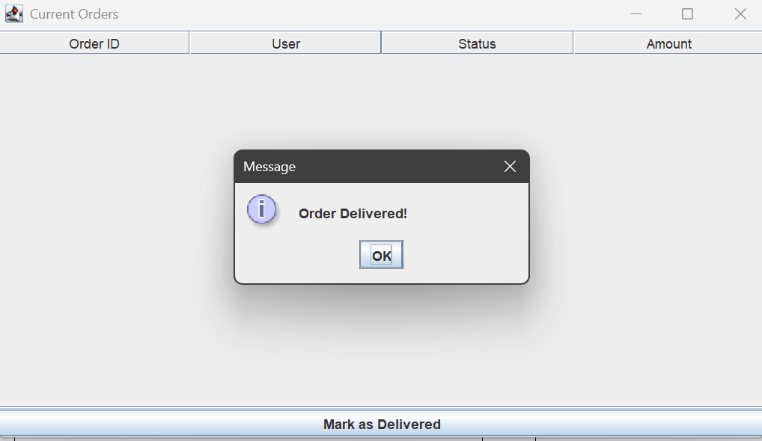

Slide 29
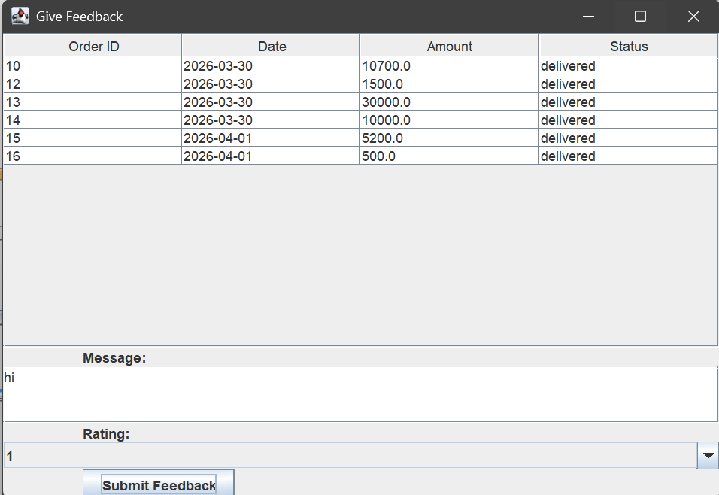

Slide 30
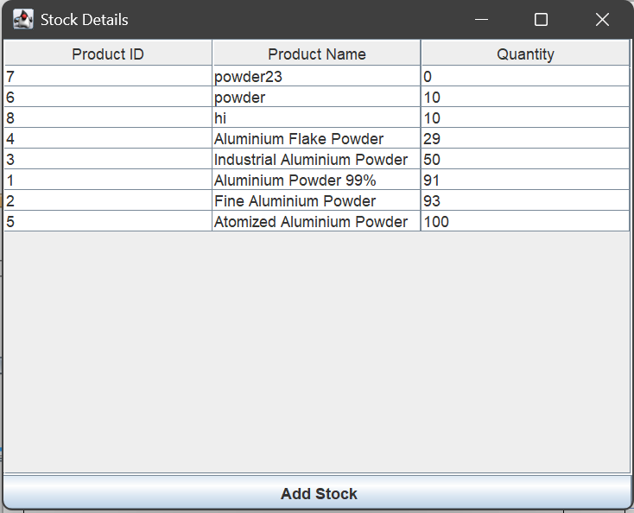
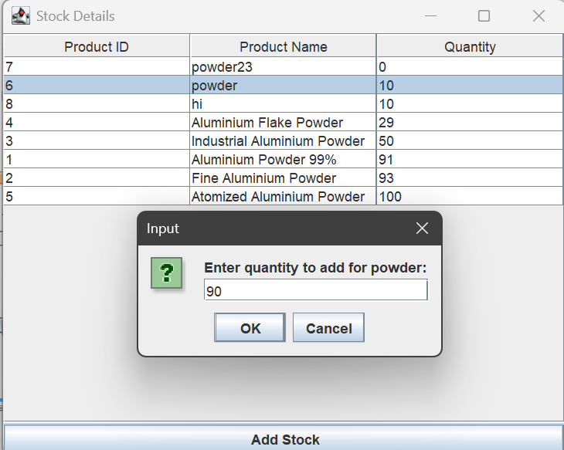

Slide 31
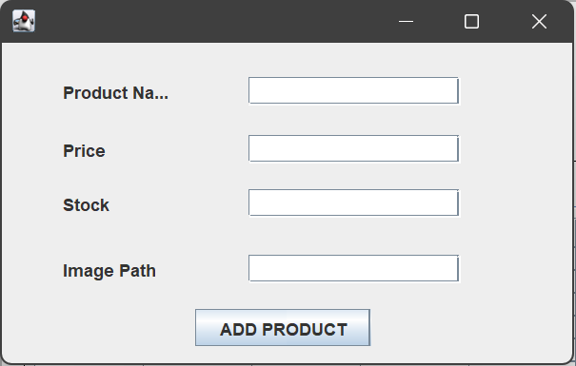

Slide 32
CODING:
PROJECTS\MINI PROJECT\SEM 4\FULL CODE.docx

Slide 33
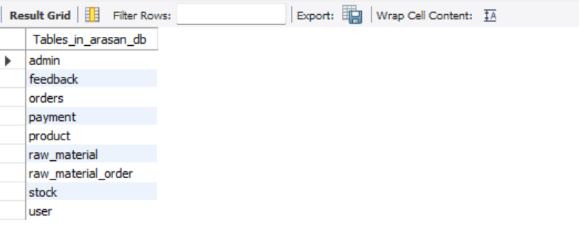
TABLES:

Slide 34
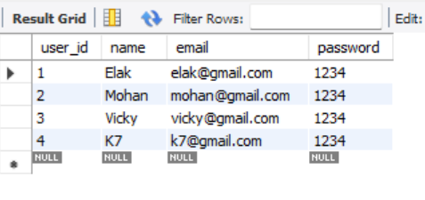
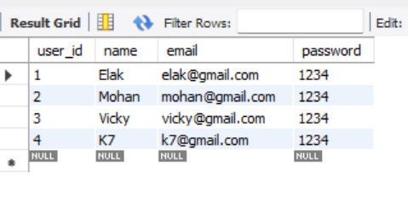

Slide 35
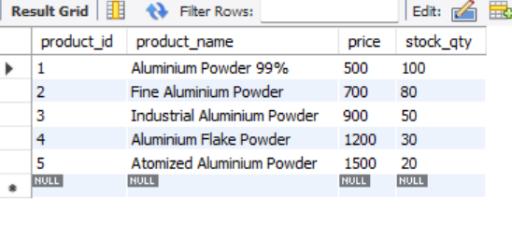
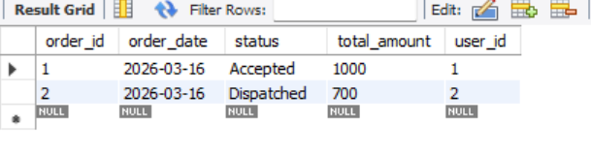

Slide 36
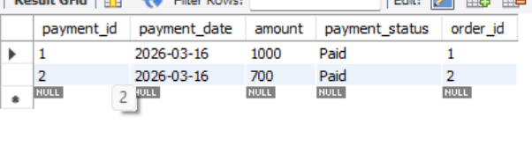
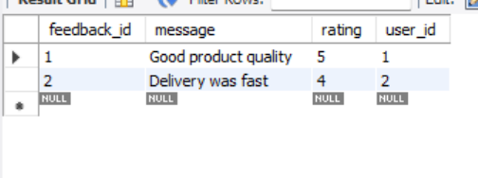

Slide 37
